Slide 1
Deposition Rate Optimization; Thin-Film
Technical Presentation for SensArray Division
Varad Lad | Mechanical Manufacturing Design Engineer

Slide 2
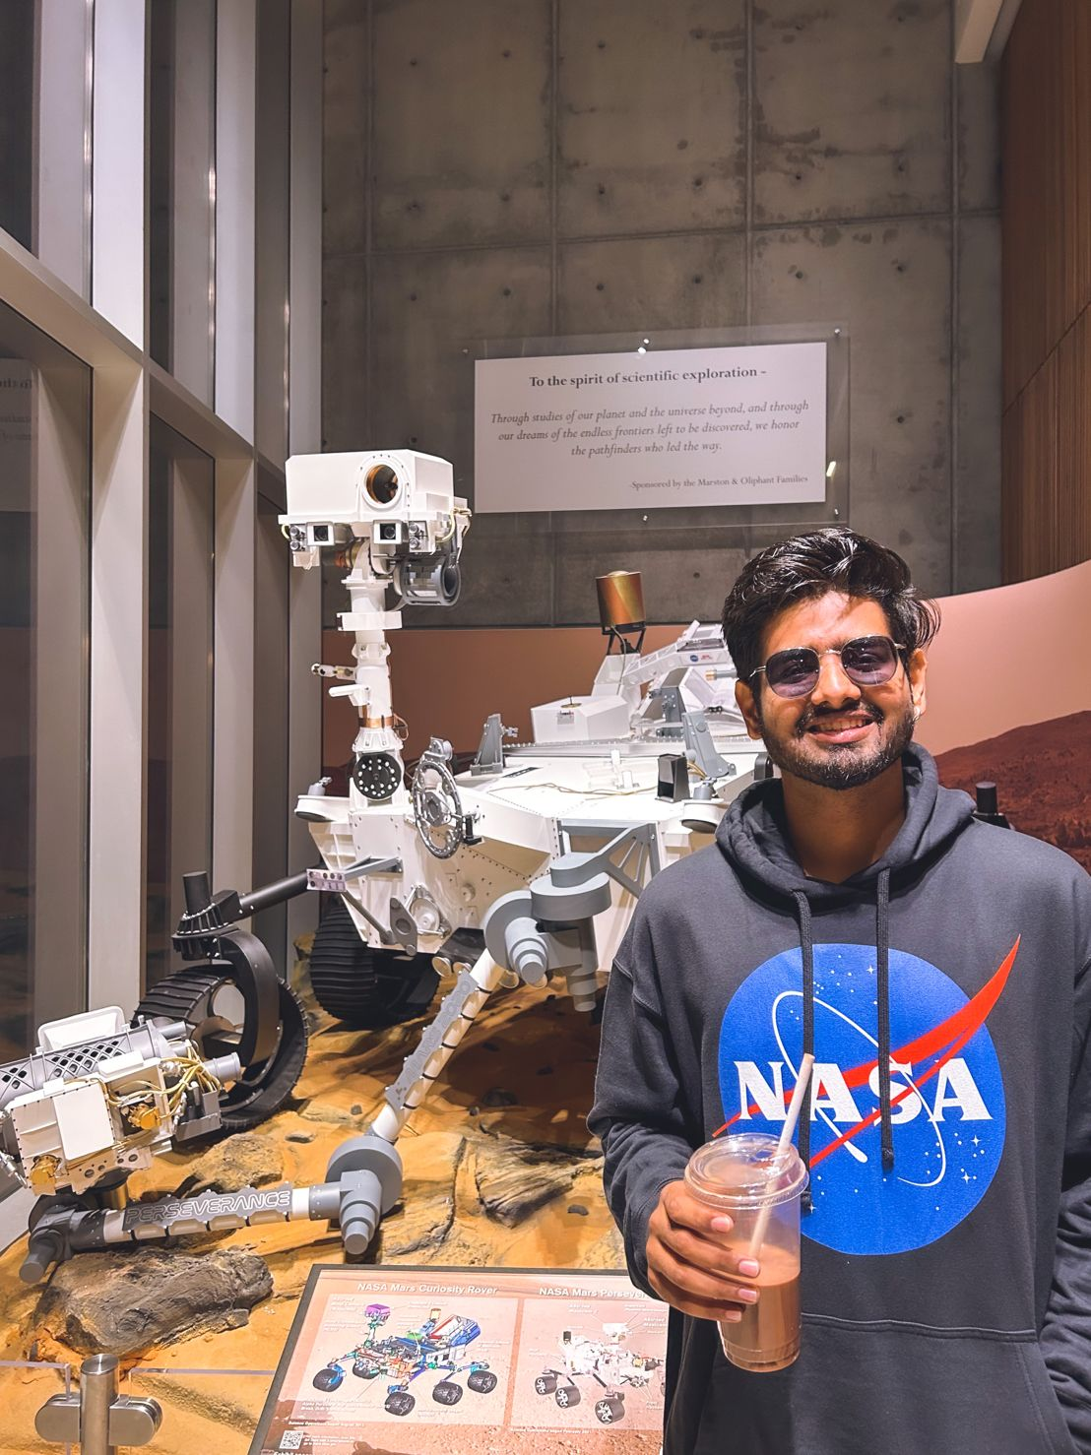
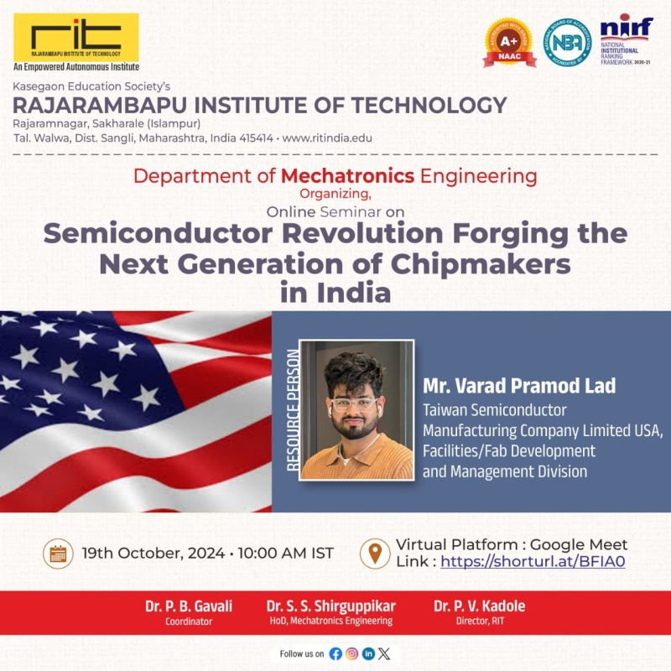
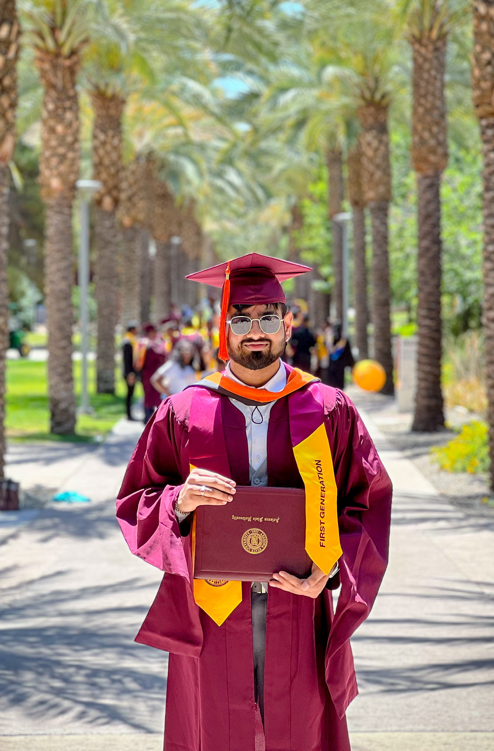

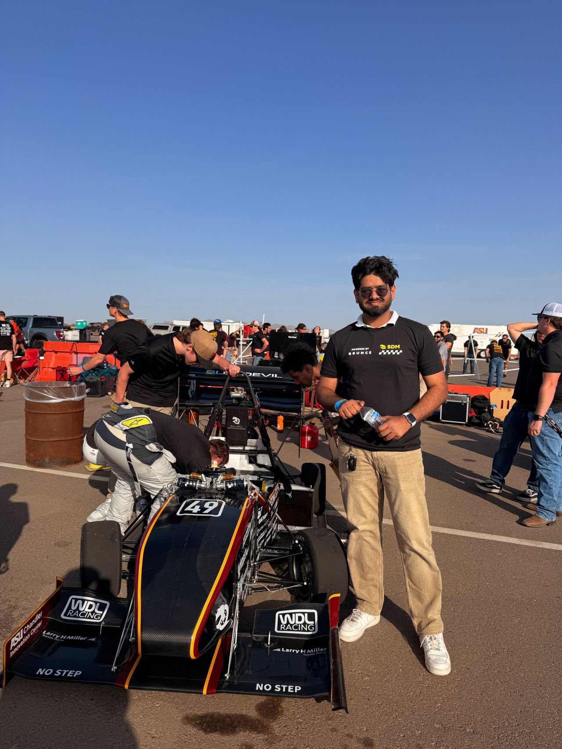

Introduction & Background
Varad Lad, MS in Mechanical Engineer at Arizona State University
5 years across Mechanical & Semiconductor field
Previously at TSMC, NASA, Rayn Innovation, Marketech International (Taiwan Team), Chemtech Systems etc
Achievements:
ASU SunAward of Excellence
Spokesperson for Material Research Seminar in Seattle
TSMC President of employee collaboration club
International university + K12 educator for semiconductor tech
Research writer for ”Space For Humans” & NASA Intern
Supported ASU’s FSAE team
Notes:
Over the 5 years in industry, I’ve worked at the intersection of mechanical design, semiconductor fab systems, and thermal engineering.
The big names I have worked with until now are TSMC, NASA and I have also worked at startups or small scale companies like Ryan Innovation, Marketech International, Chemtech etc Outside of work:

Slide 3
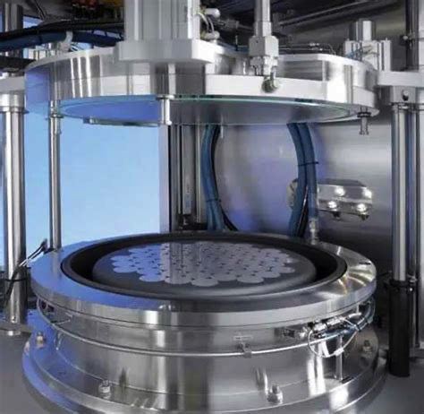
Deposition Rate Optimization for Thin-Film Material @Rayn Innovation & ASU | R&D Division
Project Scope:
Semiconductor manufacturing relies on high-performance thin-film deposition processes
Deposition rate – the speed of film growth – is critical for factory throughput and cost efficiency
This project focused on optimizing the deposition rate for semiconductor materials without compromising film quality
Approach:
Combines a structured engineering design approach with advanced data-driven optimization (Design Of Experiments DOE and Bayesian methods)
Achieve substantial improvements in deposition performance (significantly higher rate, lower variability)
Notes:
Let’s move to more Technical part of the presentation I’ll be presenting an overview of my project on optimizing deposition rate for semiconductor thin films – a topic highly relevant to improving manufacturing efficiency. In semiconductor fabrication, deposition rate – essentially how fast we can lay down a thin film – directly impacts throughput, cost per wafer, and even device performance if not carefully managed. My work addresses the challenge of increasing deposition rate while maintaining strict film quality standards. The presentation is structured in a design–analysis–results flow, demonstrating a structured approach. I'll cover how I identified the problem and requirements, combined a methodology using both classical design of experiments and modern Bayesian optimization, implemented the solution, and achieved substantial improvements in process performance. This project draws on my research at ASU and an R&D internship at Rayn Innovation, showcasing technical depth in process optimization and design.

Slide 4
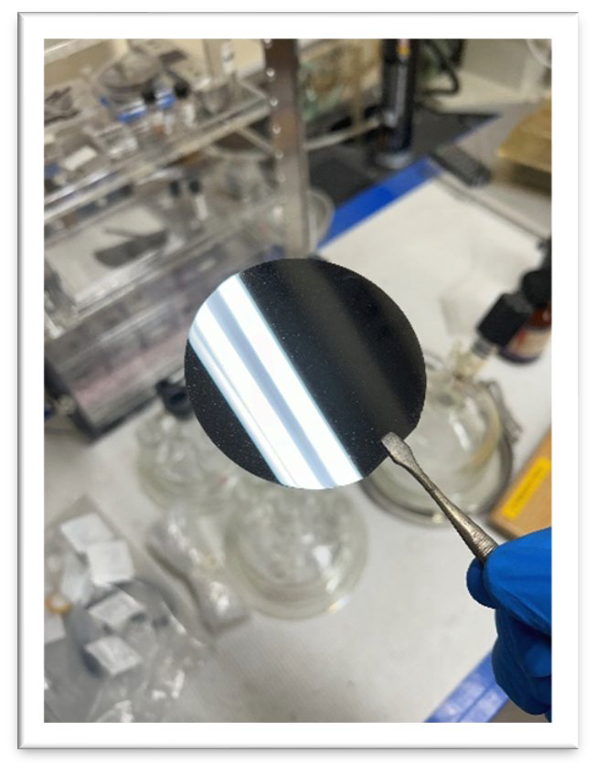
Background
Initial state:
Baseline deposition process had suboptimal rate and high variability – limiting yield
Problem drivers:
Multiple process parameters (temperature, pressure, chemical precursors, etc.) interact nonlinearly, making it hard to find optimal settings by trial and error
Challenge:
Accelerate the deposition rate while ensuring uniform film thickness and quality across wafers
Traditional methods or default equipment settings were not delivering the desired efficiency
Notes:
In setting the initial stage, let me describe the baseline situation. The deposition process in question could be a thin-film process like chemical vapor deposition (CVD) or a hybrid spin-coating method – in any case, a technique used to create critical layers on semiconductor wafers.
Originally, this process's deposition rate was too low for our yield goals, meaning each wafer took longer than ideal to coat.
The root cause is that deposition outcomes depend on many interdependent parameters: for example, substrate temperature, chamber pressure and gas flow affect film growth, plasma power (if using plasma-enhanced deposition), and in spin coating, rotation speed and solution chemistry matter.
Manually tuning these parameters in a complex, and impractical.
The goal was clear: increase the deposition rate substantially, but without sacrificing film quality or uniformity. rigorous, data-driven solution rather than guesswork.

Slide 5
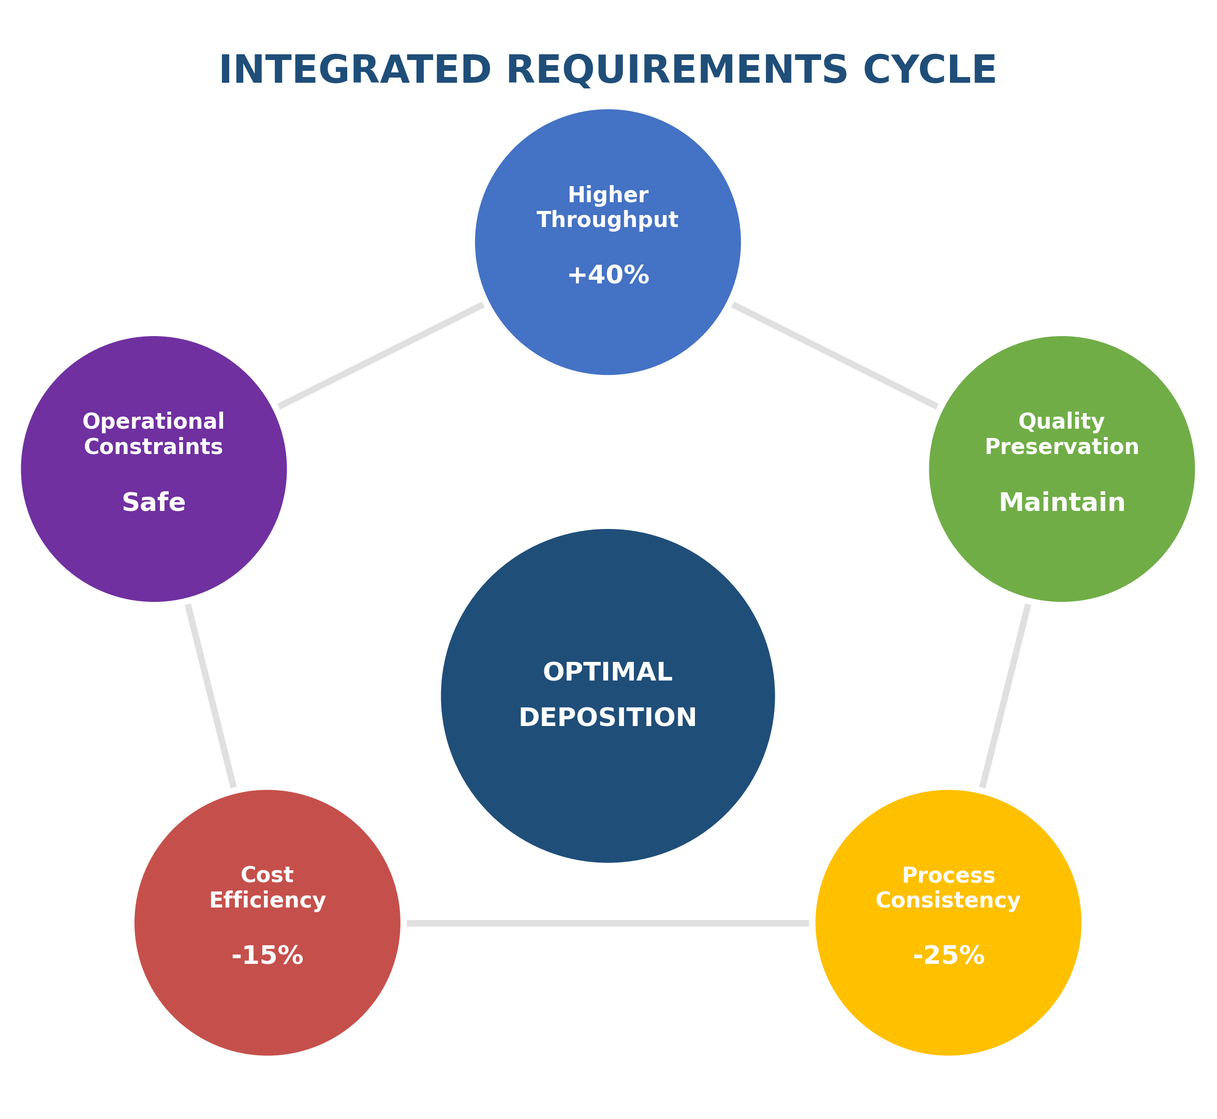
User Requirements (pre-defined)
For Optimal Deposition:
Higher Throughput
Quality Preservation
Consistency
Cost Efficiency
Operational Constraints
Notes:
Before designing the solution, I formalized the user requirements – effectively, what the process stakeholders (manufacturing engineers and management) needed from this optimization project.
First and foremost, throughput needed to increase. We set an aggressive target in practical terms, if it originally took, say, 1 hour to deposit a film, we wanted to cut that time – aiming for something like 40% faster deposition, which would dramatically improve manufacturing productivity.
Crucially, any speed improvement must not come at the expense of quality. The deposited films still have to meet all specifications:
consistency, thickness uniformity across the wafer, correct microstructure and composition, and no adverse effect on device performance.
Another requirement was cost-effectiveness. We couldn't simply throw an expensive new machine or exotic materials at the problem.
The optimization should leverage existing equipment and be implemented via process parameters or minor additions, thereby potentially reducing cost per wafer
Finally, we had to respect operational constraints must remain within equipment safety limits; By laying out these requirements, we had clear targets and boundaries for the design and optimization efforts

Slide 6
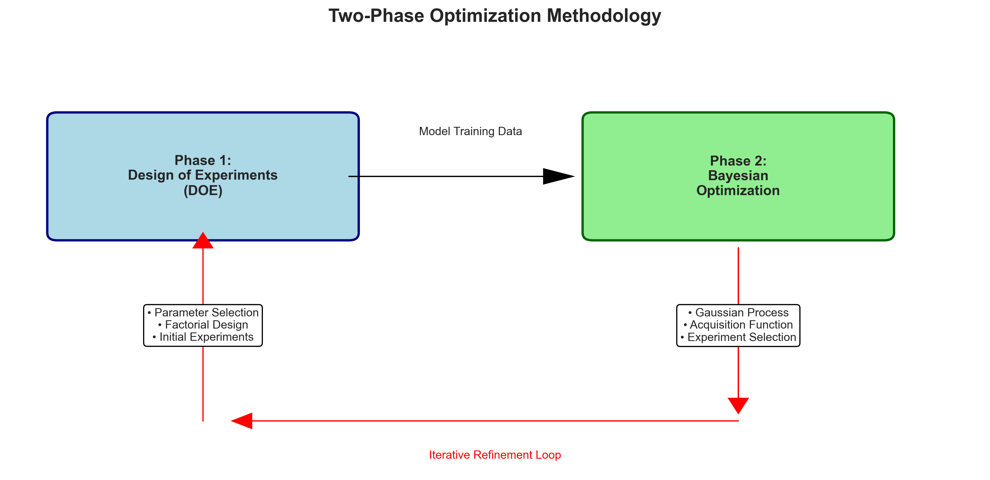
Concept & Methodology
Notes:
To meet those requirements, I devised a two-phase optimization strategy of classical experimental methods with advanced computational optimization.
In Phase 1, Design of Experiments (DOE) provided a foundation. Here I used a structured experimental plan – for example, a factorial design – to change the major deposition parameters in a systematic way.
The idea was to efficiently generate data on how each factor influence deposition rate and film quality. DOE is critical in complex processes like this, rather than one-at-a-time trial and error.
With that groundwork laid, we moved to Phase 2, Bayesian Optimization.
Bayesian optimization is a machine learning-based approach well suited for optimizing complex processes with multiple inputs. Using the original model as a starting point the algorithm predicts new parameter sets to try, aiming to find the maximum deposition rate efficiently. Each iteration, we update the Phase 2 model with the latest experimental result.
All along, we run concurrent quality checks. For every experiment recommended by the algorithm, we not only measure deposition rate but also check film quality using appropriate metrology. This closed-loop approach reflects a kind of automated process optimization that's more efficient than a purely manual search. Overall, the concept was to let data and probabilistic modeling lead us to an optimum goals.
🎯 What This Image Shows:
----------------------------------------
- Two-phase optimization methodology with clear visual flow
- Phase 1 (Blue Box): Design of Experiments (DOE) foundation
- Phase 2 (Green Box): Bayesian Optimization implementation
- Black Arrow: Data flow from DOE to Bayesian phase
- Red Feedback Loop: Iterative refinement process
- Sub-process Details: Key activities in each phase
🗣️ How to Present This:
----------------------------------------
"*"This diagram illustrates our two-phase optimization strategy. We begin with Design of Experiments in Phase 1 to establish a solid foundation - this gives us structured data about how key parameters affect deposition rate. This data then feeds into Phase 2, where Bayesian optimization takes over. Notice the red feedback loop - this represents the iterative nature of our approach, where each experiment result refines our model and guides the next experiment. This systematic methodology is far more efficient than random trial-and-error approaches."*"

Slide 7
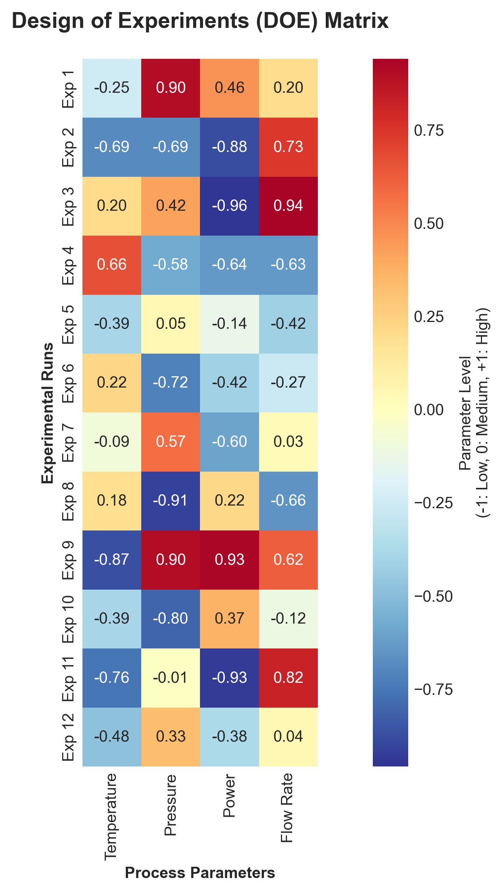
Decision Framework (DOE & Design)
Key parameters identified:
Substrate temperature
Chamber pressure
Reactant gas flow
Plasma RF power (if applicable)
Spin speed
DOE matrix setup: Employed a Design of Experiments approach (full-factorial or fractional-factorial design), parameters at high, medium, low levels.
Data-driven decisions: DOE results decision tree to identify the parameter range where deposition rate trends upward without quality loss, then concentrate
Screening vs optimization: Initial DOE for screening experiment to narrow down critical factors.
Notes:
In executing the methodology, we followed a clear decision framework. First, we pinned down which parameters to include in the study. Taken from process experts and literature, we identified factors likely to affect the deposition outcomes.
For a thin-film deposition scenario, that typically includes things like:
the temperature of the substrate or solution, which can affect reaction kinetics;
the pressure or ambient gas environment in the chamber ,
the gas flow rates or precursor concentrations
the plasma power (for plasma-enhanced processes) which controls energy input;
and in a spin coating context, the spin speed and time, affecting film thickness.
With those key parameters, we constructed a DOE matrix – essentially a table of experimental systematically mentions each factor.
(We might use a full factorial design if factor count is low, or a fractional factorial if we have many factors to keep experiments efficient).
In this project, the DOE allowed us to observe, for example, how deposition rate responds when we go from low to high temperature, or low to high power, and how those effects might interact with each other
Essentially, after DOE, we decided: which parameter ranges are worth exploring more deeply and which can be fixed.
In summary, to make this project successful we had to be certain about the parameters that we chose to optimize; not just the guesswork
🎯 What This Image Shows:
----------------------------------------
- 12 experimental runs (rows) vs 4 key parameters (columns)
- Color-coded parameter levels: Red (High), White (Medium), Blue (Low)
- Factorial design structure: Systematic coverage of parameter space
- Balanced exploration: Even distribution across parameter combinations
- Numerical values: Normalized levels from -1 (low) to +1 (high)
🗣️ How to Present This:
----------------------------------------
"*"This heatmap visualizes our Design of Experiments matrix. Each row represents one experimental run, and the colors show parameter levels - red for high, blue for low, white for medium. Notice the systematic pattern - this isn't random testing. We used a fractional factorial design to efficiently explore the parameter space with just 12 experiments instead of hundreds.

Slide 8
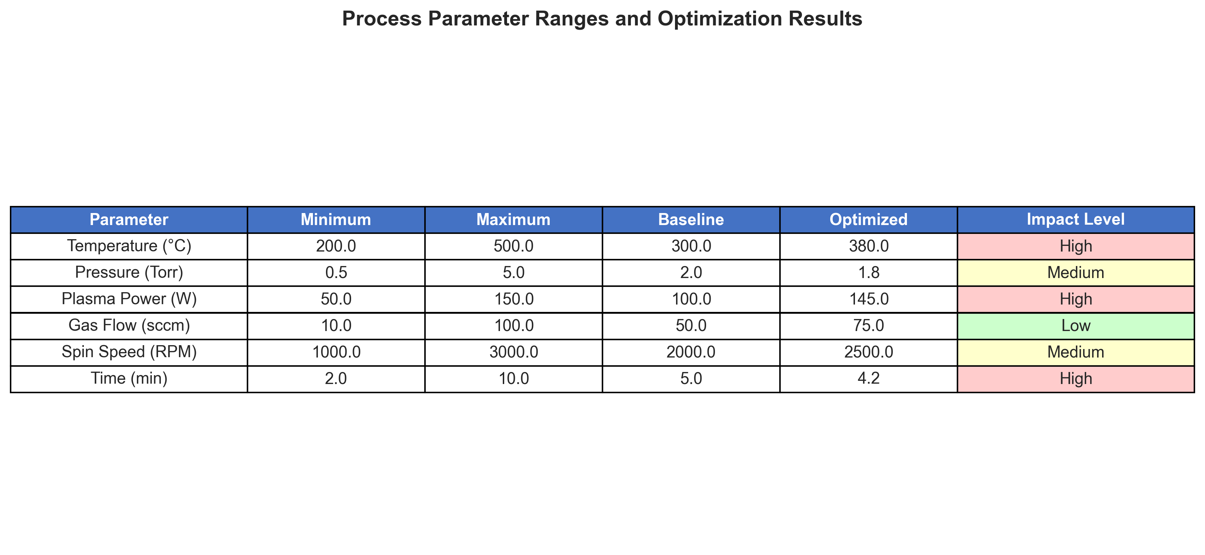
Equipment & Parameter Mapping
(After Experiment)
Utilized the existing deposition tool (Spin Coater) logged data for each run (deposition time, thickness achieved) to calculate initial/optimized deposition rate
From DOE results, developed a quantitative model (e.g. regression) linking parameters to deposition rate.
Python scripts to integrate with the deposition equipment's data and to run the Bayesian optimization routine. The code gave new parameter values, which were then applied and tested in the lab
Notes:
Now let me delve into some technical specifics of the implementation and how we mapped parameters to outcomes.
The experimental setup leveraged the existing deposition tool in a controlled manner.
-We began by clearly defining the parameter space. For each relevant factor, we set a lower and upper limit based on physical and equipment constraints.
For example, we might allow substrate temperature from 200 °C up to 500 °C – below 200 is too low for meaningful deposition in our case, and above 500 might risk equipment safety or material degradation.
-Chamber pressure might range from moderate vacuum to near-atmospheric depending on the process
-In the spin coating scenario, spin speed and solution concentrations were similarly bounded. Laying out these ranges ensured the optimization search stayed in realistic territory.
We ensured the tool's control systems (for temperature, gas flow, abatement.) were calibrated.
Deposition rate was calculated typically as thickness divided by deposition time (for instance, nanometers per minute).
___________________
With the DOE data in hand, we built a parameter-effect model.
An example relationship we saw: deposition rate generally increased with plasma power, which makes sense since higher power can create a denser plasma accelerating film growth. However, this wasn't unbounded – by the max power tested, the gain in rate was lowering indicating maybe other factors became limiting.
________________________________
Finally, on the automation front, I developed Python scripts to streamline the process. These scripts took in the current dataset,
Where possible, I interfaced this with the lab equipment's software – not full autonomous control (since manual oversight was needed for safety), but at least to easily set the recommended parameters and log the results.
This integration of coding with lab experimentation not only saved time but also reduced human error in the iterative process.
It essentially allowed us to implement a feedback loop for each experiment's result 🎯 What This Image Shows:
----------------------------------------
- Six key process parameters with their operating ranges 🗣️ How to Present This:
----------------------------------------
"*"This table summarizes our parameter space and optimization results. for example, temperature from 200°C to 500°C to avoid material degradation. The color coding shows parameter impact levels. Our optimization found that the sweet spot was at 380°C, higher power at 145W, and optimized flow rates.
These aren't extreme settings, but rather intelligent parameter combinations that maximize deposition rate while staying within safe operating windows."*"

Slide 9
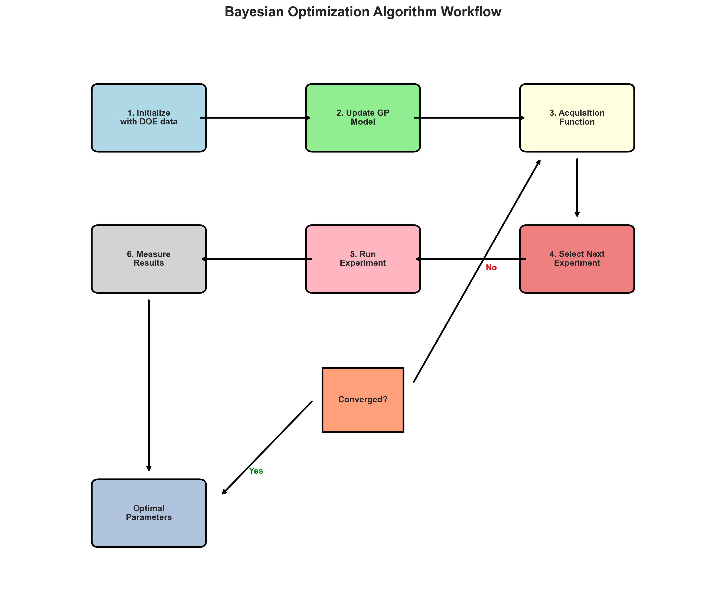
Bayesian Optimization Code and Analysis
Bayesian optimization rationale chosen for its efficiency in navigating complex, unknown response surfaces with minimal experiments.
Uses a probabilistic model (Gaussian Process) to predict deposition rate and an acquisition function to select the most informative next experiment
Algorithm workflow: Initialize → Model Update → Acquisition → Experiment → Iterate until convergence
Notes:
A highlight of this project was the application of Bayesian optimization – a modern approach that is very effective for this kind of problem. Let me explain how it works and how I implemented it, as it showcases both my coding skills and understanding of advanced optimization.
Why Bayesian optimization? In essence, it's ideal when experiments are time-consuming or expensive (as in semiconductor process trials) and when the relationship between inputs and output is complex (non-linear, multi-dimensional).
We specifically used a Gaussian Process (GP) model, which is a powerful regression technique. The GP give a prediction for deposition rate;
The algorithmic workflow was as follows:
1. Initialize: We feed initial data (from DOE) into the Gaussian Process model.
2. Model Update: The GP is trained on these points, effectively learning how deposition rate behaves.
3. Acquisition Function: This is a crucial component. We used an acquisition function such as Expected Improvement (EI), which calculates for each potential set of parameters and
the expected gain in the deposition rate if we tried that point,
considering the predicted sets.
Points where the model is very uncertain or where it predicts a high value will score well.
The code then picks the next experiment where this expected improvement is maximal.
4. Perform Experiment: We then actually set those conditions in the lab and run the deposition, obtaining a real measured deposition rate.
5. Update Data: We then add that data back into the model – essentially telling the code the true result for that point.

Slide 10
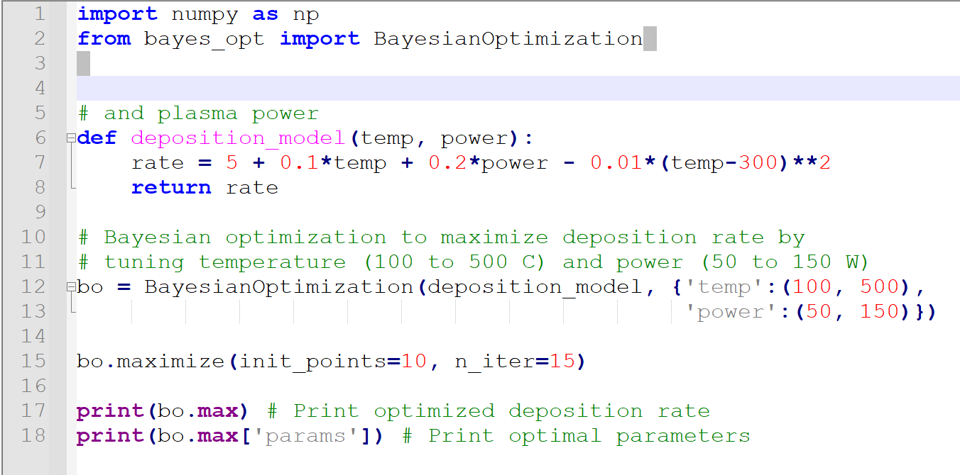
Optimization Workflow
(Sample structure/workflow)
Notes:
🗣️ How to Present This:
----------------------------------------
"*"This flowchart shows how Bayesian optimization works in practice. We start with our DOE data, then the Gaussian Process model learns the relationship between parameters and deposition rate. The acquisition function is the smart part - it decides where to experiment next. After each experiment, we update our model and repeat. we stop when further experiments aren't likely to yield significant improvements.
Key Talking Points:

Slide 11
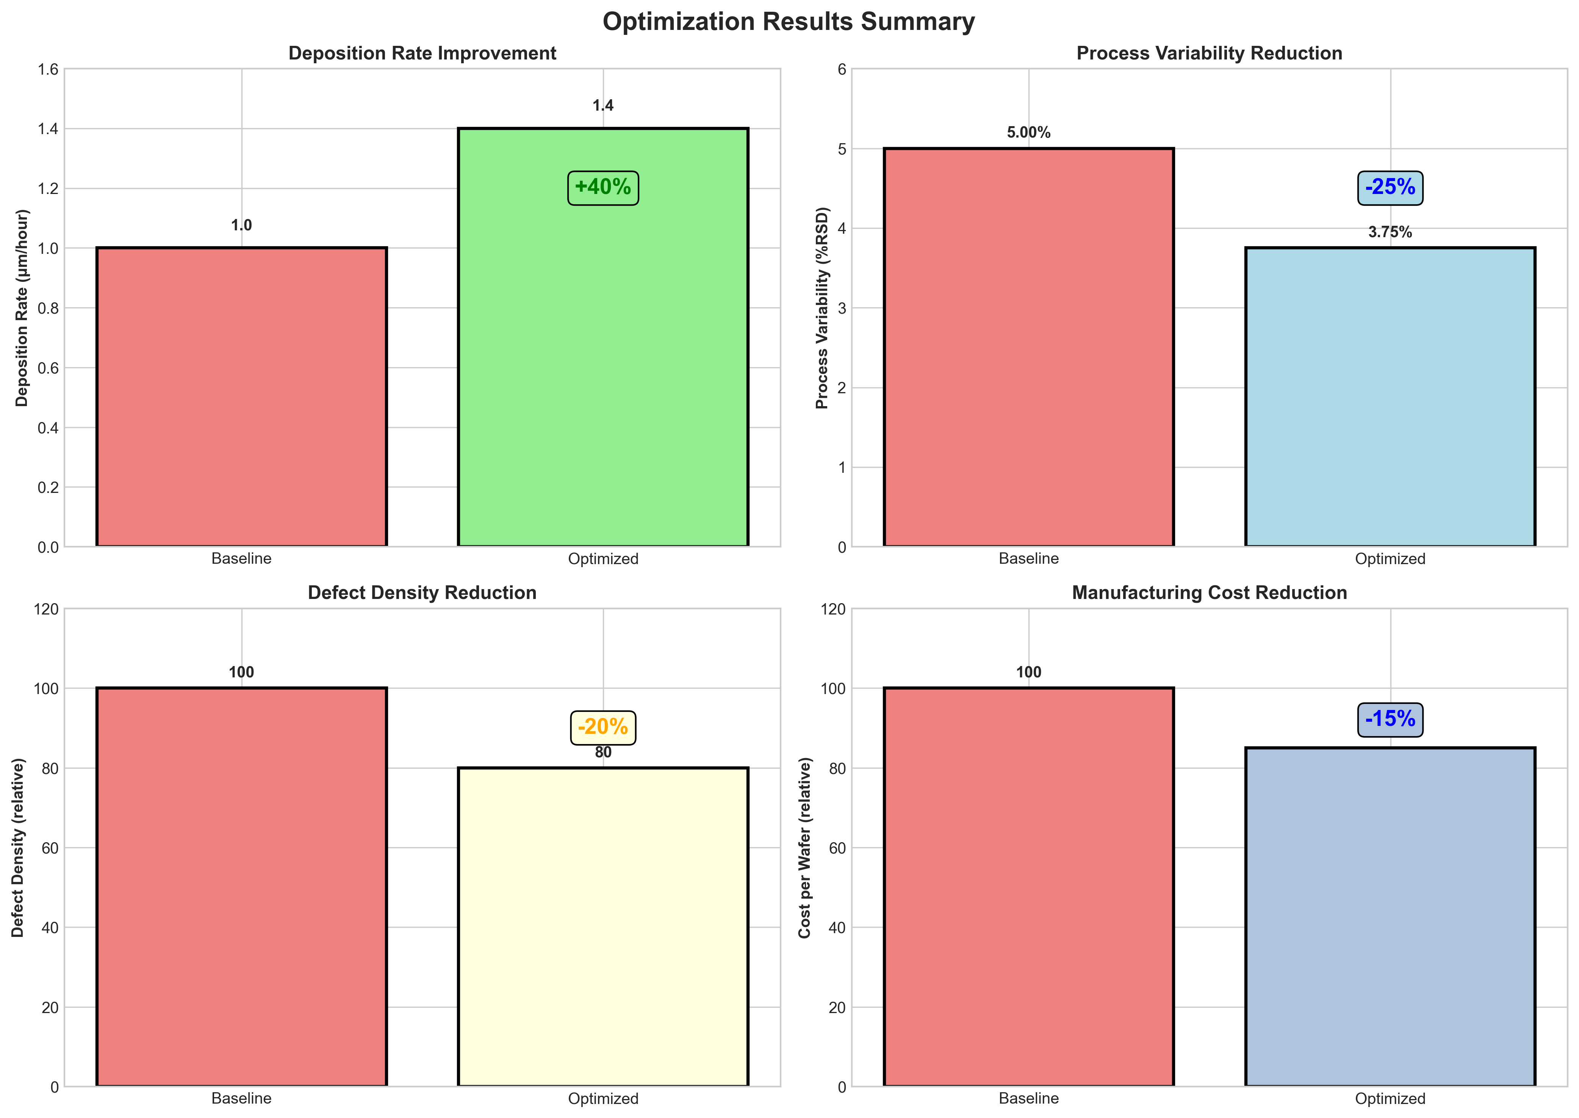
Results
Cut by ~25%
More consistent film thickness $ uniformity
40% faster
Eg: 1 µm/hour to ~1.4 µm/hour
Reduced to ~20%
Higher yield, maintained high film quality
Projected ~15% reduction/pre-wafer cost due to shorter process time & reduced waste
Notes:
Firstly, the deposition rate was dramatically increased. We realized on the order of a 40% improvement in deposition rate after optimization . To put that into perspective: if initially it took, say, an hour to deposit a certain thickness, we can now achieve that same thickness in about 40% less time.
Secondly, process variability was significantly reduced (~25% reduction). This improvement in consistency is crucial because it leads to predictability – fewer defects, less need for rework or adjustments, etc
Third, regarding quality and yield: we ensured that speeding up the process did not degrade quality. In fact, we observed a noticeable drop in defect density (~20% fewer defects) in the optimized process, which is a bit of a bonus outcome.
Lastly, we looked at the cost implications. By reducing process time and improving yield, we calculated roughly a 15% reduction in manufacturing cost per wafer.
project delivered a comprehensive win: faster and cheaper production while maintaining quality. These results again are not significant in the FAB settings but for the lab settings they were amazing from the conventional methods. If optimized on higher scale, a significant improvement in fab setting is also possible

Slide 12
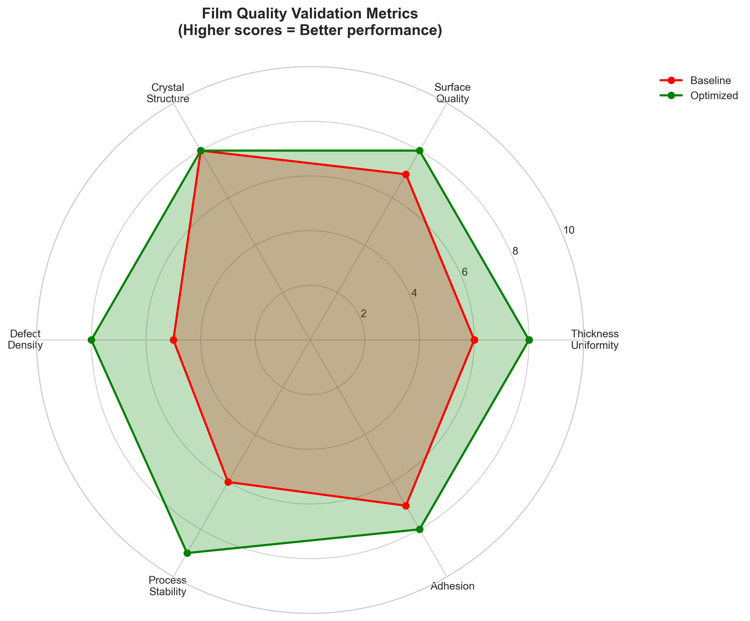
Metrology & Validation
Thickness & uniformity measurement:
Used precision optical metrology tools for UV-Vis-Spectroscopy
Microscopy & structural defect checks:
SEM (Scanning Electron Microscopy), TEM
XRD (X-ray Diffraction) on samples to check film morphology and crystal structure
Notes:
Validation was a critical part of this project. After implementing the optimized parameters, we carried out a thorough metrology campaign to ensure that the improvements were real, consistent, and did not introduce new problems.
For measuring the deposition rate and thickness, we used high-precision metrology. Typically, after each run, we measured the film thickness using tools like ellipsometry (which is great for thin-film thickness and refractive index) or a profilometer (which can step a stylus over the wafer to measure thickness). These measurements gave us the actual thickness deposited. By dividing thickness by deposition time, we got the deposition rate in, say, nanometers per minute, and those values were the basis for our improvement calculations. In some trials, where available, we also used in-situ sensors – for example, a quartz crystal microbalance (QCM) can directly monitor deposition rate in real time for R&D purposes, or the equipment's built-in rate monitor was used. The consistency between the in-situ readings and ex-situ measurements validated that our rate calculations were accurate.
We also focused on film uniformity across the wafer, which is crucial in semiconductor manufacturing (a non-uniform film can lead to device variability across a single wafer). We performed wafer mapping – using either an automated thickness mapping tool or even KLA's own sensor wafer techniques. For instance, KLA SensArray wafers can measure temperature uniformity across the wafer during processing; while our case is deposition thickness, any non-uniform temperature could hint at non-uniform deposition. We ensured the optimized runs had uniform conditions. The result: the thickness uniformity remained high – within the acceptable percentage variation across the 200 mm or 300 mm wafer (whichever size we were working with). There were no edge effect anomalies beyond what we saw in the baseline process, meaning our changes didn't cause any new uniformity issues.
Next, we examined the microstructural quality of the films using SEM and XRD. SEM images of the optimized film surfaces and cross-sections were compared with baseline runs. The images showed smooth, continuous films with no increase in roughness or porosity – in fact, in some cases slightly improved smoothness was noted, likely due to the more optimal growth conditions. XRD was used to check if the crystal structure or phase of the material remained as expected (for example, if we're depositing polycrystalline metal or oxide, we want the same phase and preferred orientation as before). The XRD spectra for the optimized process matched the baseline's in terms of peaks, indicating we didn't inadvertently change the material properties while speeding up deposition.
Defect inspection was another validation step. Using particle counters or inspection scans (the kind of tools that detect particles on wafers, which KLA also specializes in), we measured the defectivity of wafers before and after optimization. As mentioned, we found roughly a 20% reduction in defect counts on the optimized process wafers. This could be validated by a simple count on test wafers or through automated inspection routines. We also maintained SPC (Statistical Process Control) charts for key metrics – for instance, we plotted deposition rate run by run, thickness uniformity, and defect counts on control charts. After optimization, these charts showed mean shifts in the positive direction (higher rate, lower defect counts) with tighter control limits (less variability). All points were well within spec limits, indicating a stable improved process.
In summary, the validation confirmed that the optimized process is not a fluke or a solely theoretical improvement – it's empirically proven. We have high confidence that if we deploy this recipe in production, it will consistently yield the faster deposition while meeting all quality requirements. This rigorous validation is especially important in semiconductor manufacturing, where any process change must be vetted thoroughly. By using a combination of dimensional measurements, microscopy, and statistical analysis, we ensured the solution is production-ready and robust.
🎯 What This Image Shows:
----------------------------------------
- Six quality metrics arranged in a circular radar chart
- Red area: Baseline process performance
- Green area: Optimized process performance
- Scale: 0-10 scoring system for each metric
- Clear improvement: Green area consistently larger than red
📖 What It Explains:
----------------------------------------
- Multi-dimensional quality assessment: Beyond just deposition rate
- Comprehensive validation: All aspects of film quality maintained/improved
- Systematic measurement: Professional metrology approach
- No trade-offs: Optimization improved multiple quality aspects
🗣️ How to Present This:
----------------------------------------
"*"This spider chart shows our comprehensive quality validation. The red area represents our baseline process, green shows the optimized process. Notice that the green area is larger in every dimension - we didn't just maintain quality while increasing speed, we actually improved it. This includes thickness uniformity, surface quality, crystal structure, defect density, process stability, and adhesion. This multi-dimensional improvement confirms that our optimization found a fundamentally better operating regime, not just a parameter set that trades quality for speed."*"
Key Talking Points:
- Emphasize comprehensive improvement across all metrics
- Highlight the validation rigor - multiple measurement techniques
- Stress no compromise - better in every dimension
- Connect to semiconductor quality requirements

Slide 13
Deposition Rate Optimization; Thin-Film
Thank you
Technical Presentation for SensArray Division
Varad Lad | Mechanical Manufacturing Design Engineer

Slide 14
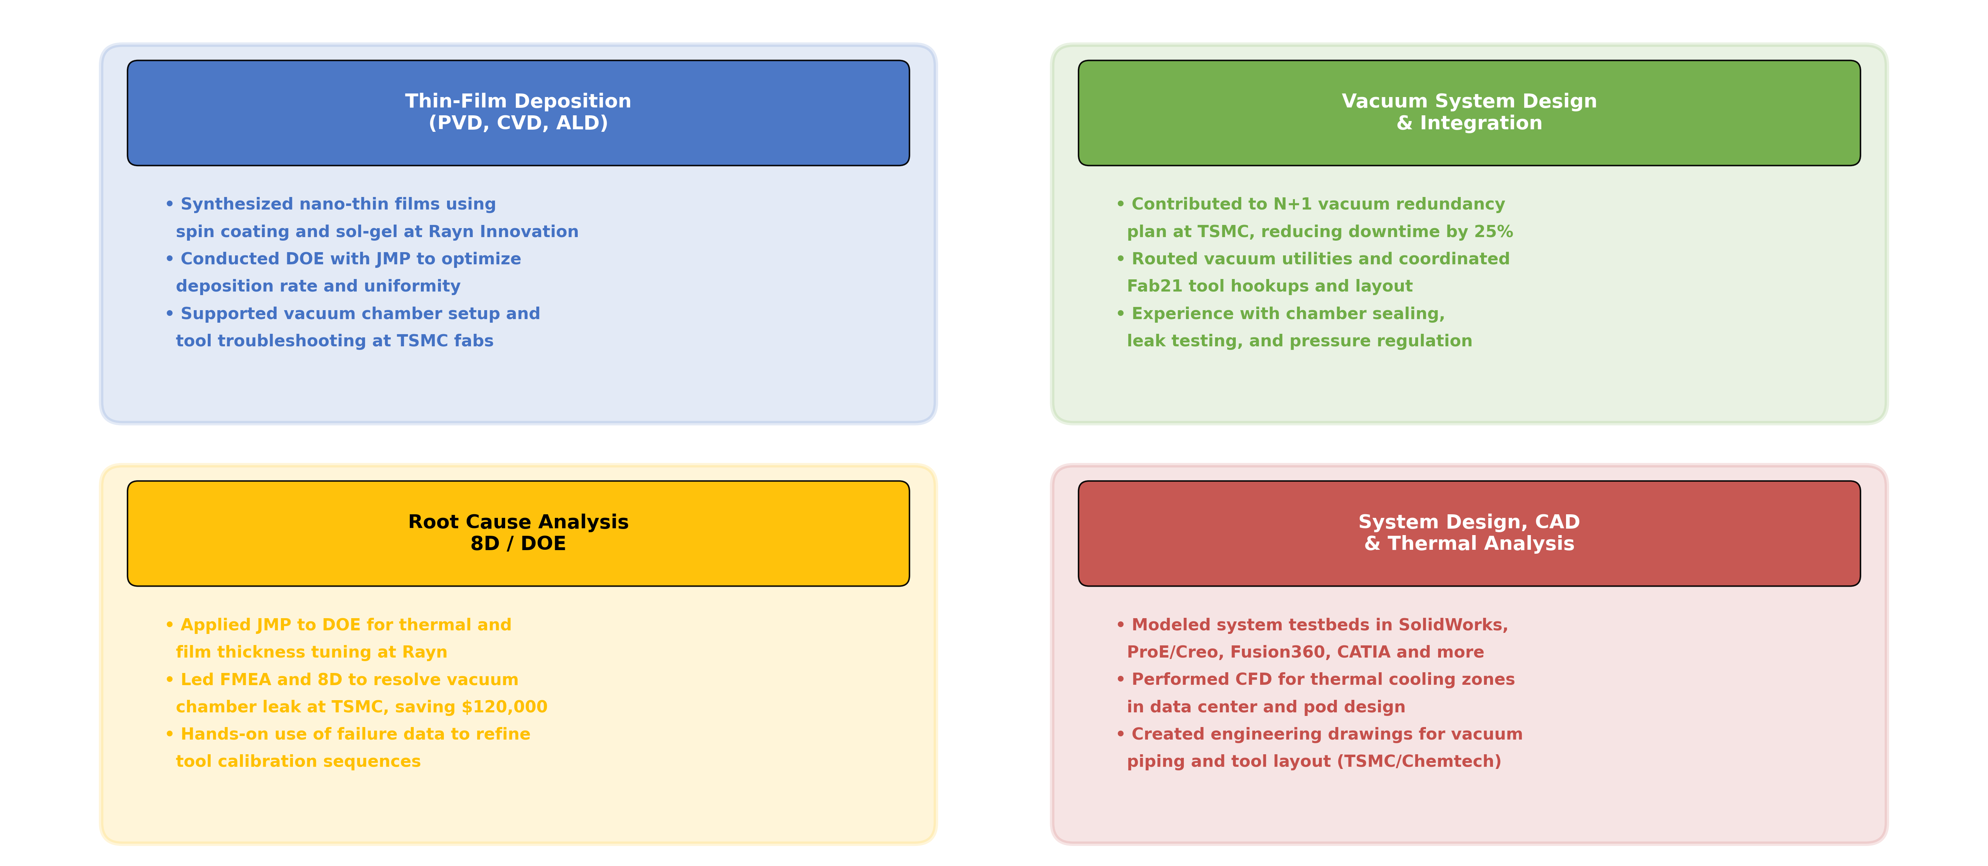
Experience SnapShot

Slide 15
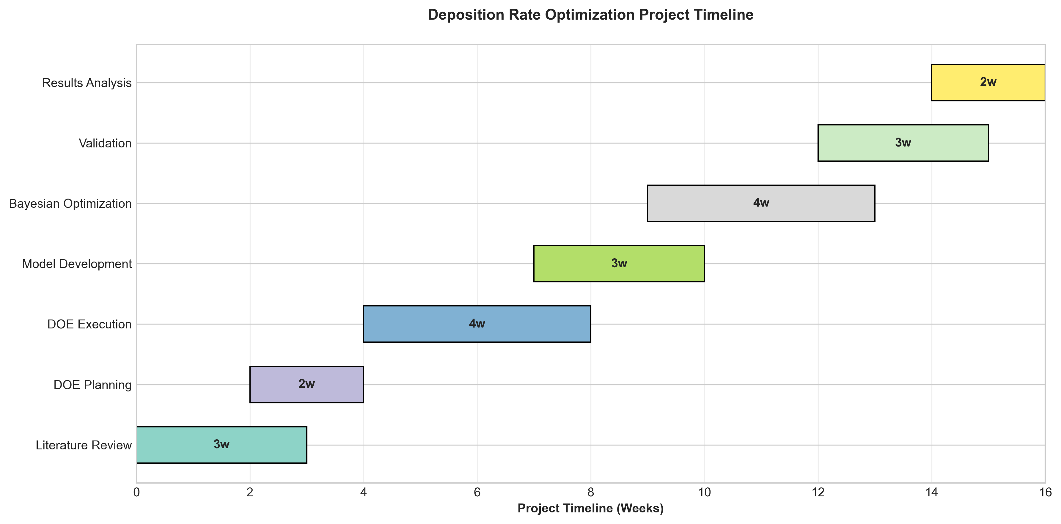
Project Timeline & Management

